Slide 1
MongoDB
Shruti

Slide 2
Cursors
Find()
toArray()
forEach()
Pretty()
Map
Limit
Count

Slide 3
Aggregations
Aggregation pipeline
Map-reduce function : Deprected
Single-purpose aggregation

Slide 4
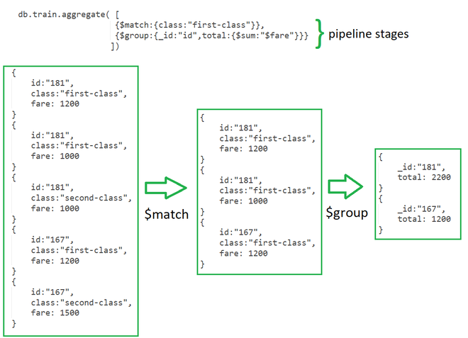
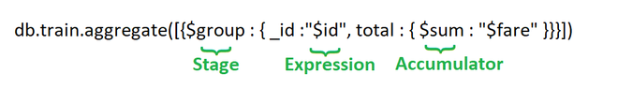
Aggregation pipeline

Slide 5
Stages
Stages: Each stage starts from stage operators which are:
$match: It is used for filtering the documents can reduce the amount of documents that are given as input to the next stage.
$project: It is used to select some specific fields from a collection.
$group: It is used to group documents based on some value.
$sort: It is used to sort the document that is rearranging them
$skip: It is used to skip n number of documents and passes the remaining documents
$limit: It is used to pass first n number of documents thus limiting them.
$unwind: It is used to unwind documents that are using arrays i.e. it deconstructs an array field in the documents to return documents for each element.
$out: It is used to write resulting documents to a new collection

Slide 6
Expressions and Accumulators
It refers to the name of the field in input documents for e.g. { $group : { _id : “
$id“, total:{$sum:”$fare“}}} here $id and $fare are expressions.
Accumulators: These are basically used in the group stage
sum: It sums numeric values for the documents in each group
count: It counts total numbers of documents
avg: It calculates the average of all given values from all documents
min: It gets the minimum value from all the documents
max: It gets the maximum value from all the documents
first: It gets the first document from the grouping
last: It gets the last document from the grouping
Note:in $group _id is Mandatory field
$out must be the last stage in the pipeline
$sum:1 will count the number of documents and $sum:”$fare” will give the sum of total fare generated per id

Slide 7
Map Reduce
Map reduce is used for aggregating results for the large volume of data. Map reduce has two main functions one is a map that groups all the documents and the second one is the reduce which performs operation on the grouped data.
Syntax
db.collectionName.mapReduce(mappingFunction, reduceFunction, {out:'Result’});

Slide 8
Single Purpose Aggregation
It is used when we need simple access to document like counting the number of documents or for finding all distinct values in a document. It simply provides the access to the common aggregation process using the count(), distinct(), and estimatedDocumentCount() methods

